Slide 1
BP3D Runtime EDA and Prediction

Slide 2
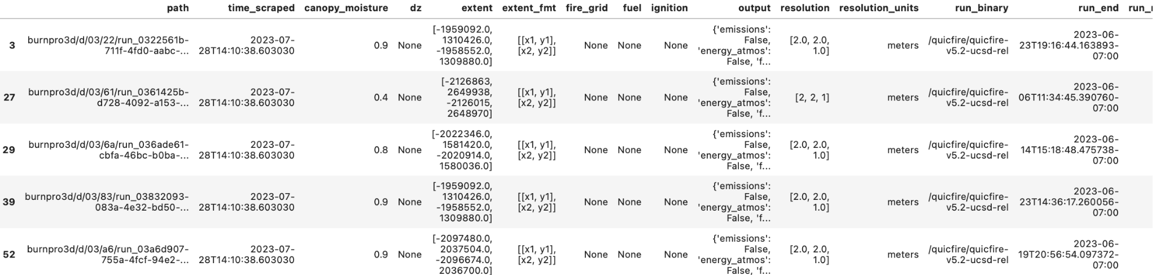
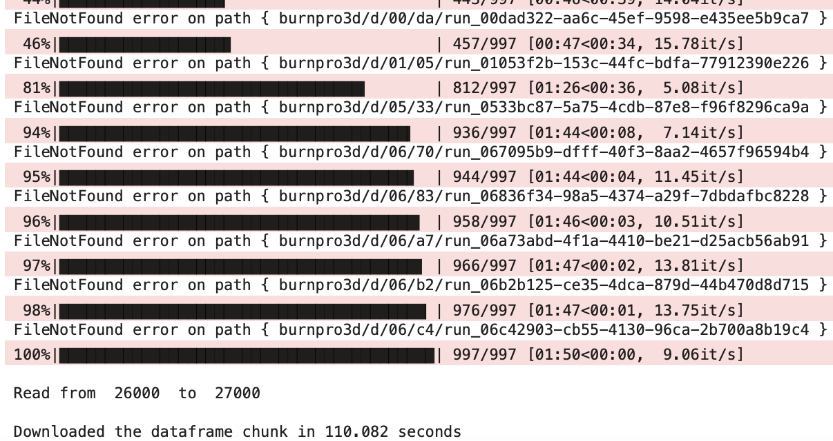
Collect and Scrape Data

Slide 3
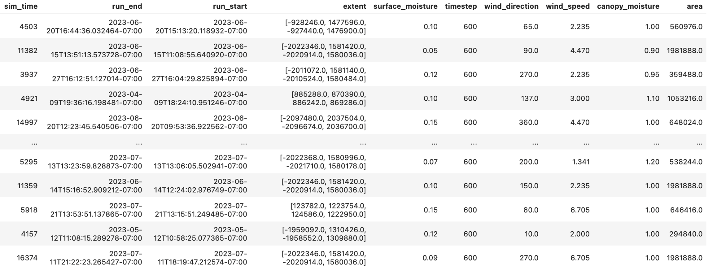
Data Transformation Initial

Slide 4
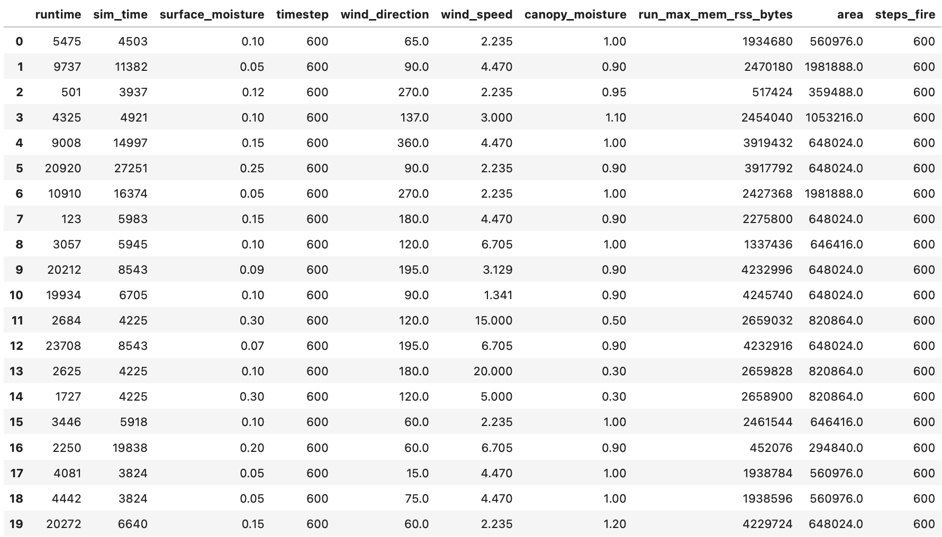
Data Transformation 2
Drop unhelpful columns and non number columns
Extract fire_steps from output column
Turn path into just the run id to match up later with UUID
Create runtime feature from calculating end time - start time
This is the target data for all ML models
Drop any duplicate rows (there were 13 that appeared from the data scraping process in batches)

Slide 5
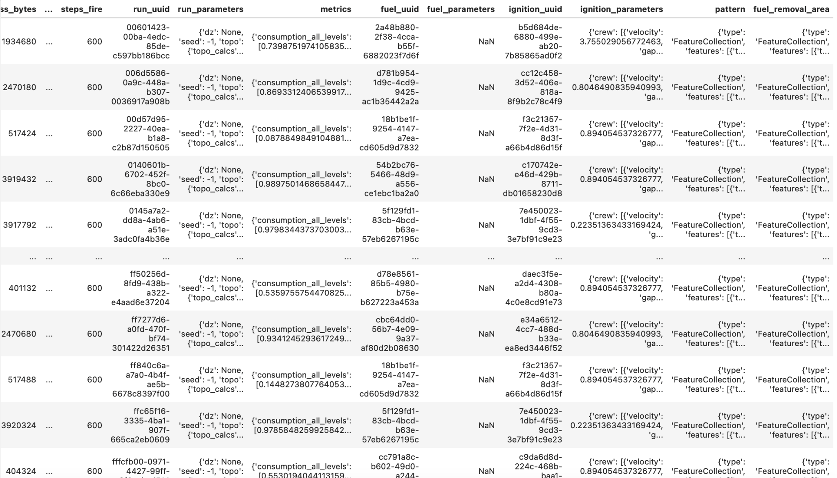
Extract data from runs_db.csv

Slide 6

Exploratory Data Analysis
Key Questions:
what features are most and least relevant for the models to be effective at prediction?
How is the entire dataset distributed among the different features? What kinds of trials are lacking?

Slide 7
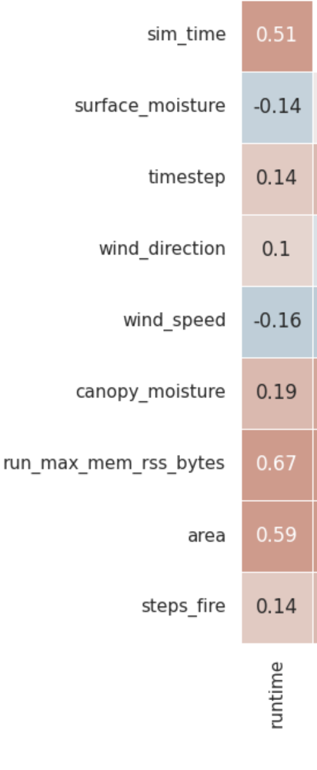
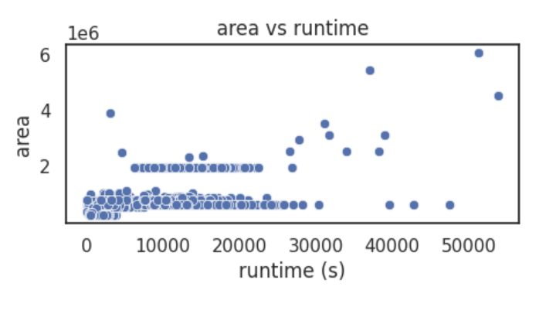
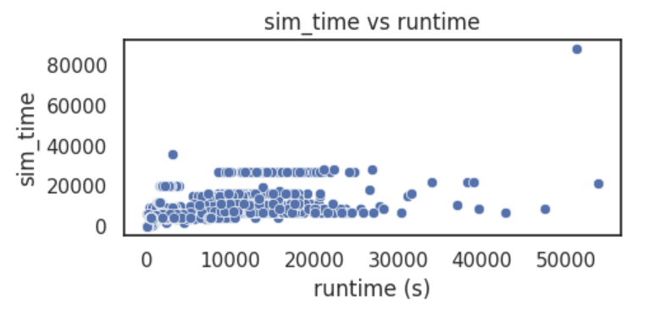
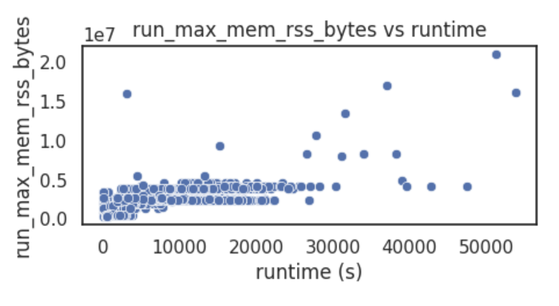
How Correlated is Each Variable to Runtime?
Correlation
These 3 variables have the best correlation numerically from the plot on the right, but also just visually from graphing every feature. Most features have no visual pattern, but these at least have a weak one.

Slide 8
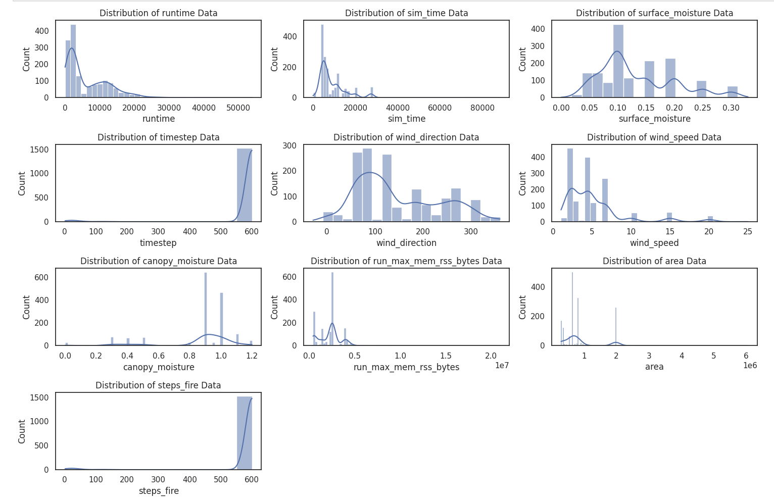
How is the Dataset Skewed?
Most of the runs are between 0 and 3000 seconds, with fewer data points for higher run times. It seems wind speed is usually run with 0-5 and canopy moisture almost always 0.9. For other features like area and run_max_mem_rss_bytes, there is a few large outliers. It would help the models to remove these outliers.
Notes:
There is a lot of information about shorter runtimes below 10000 seconds. There’s not a lot of trials with wind speed above 10, canopy moisture below 0.8 etc. Those predictions would likely be less accurate.

Slide 9
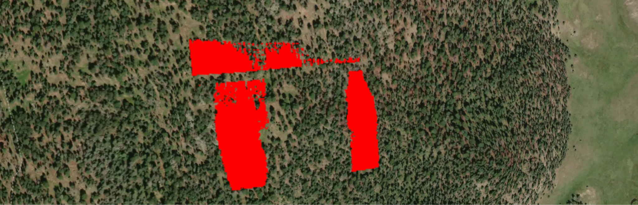
Ignition and Fuel Data
As provided by runs_db.csv, lets see what is there once it is matched up by run id

Slide 10
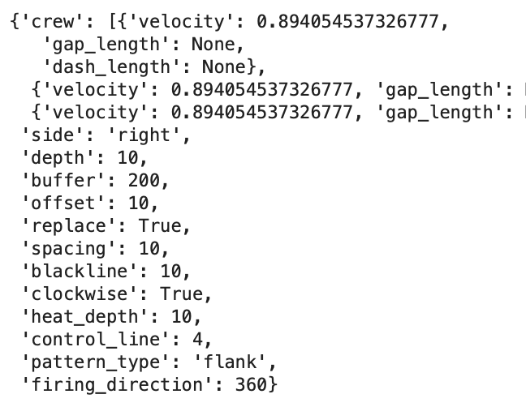
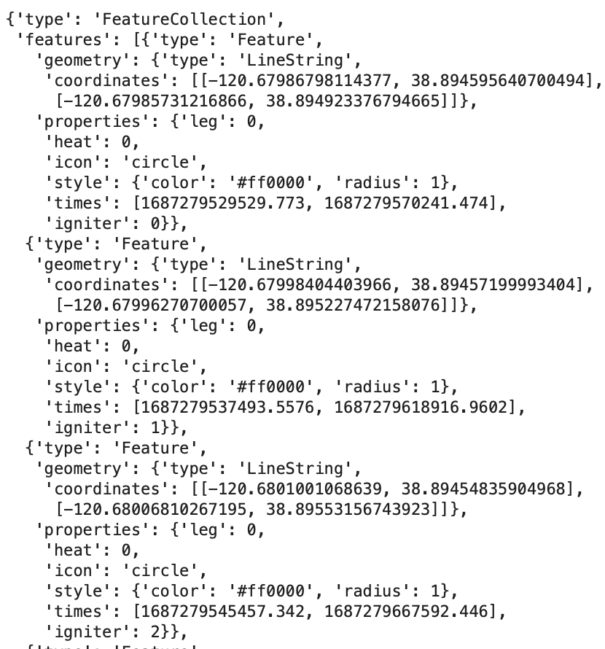
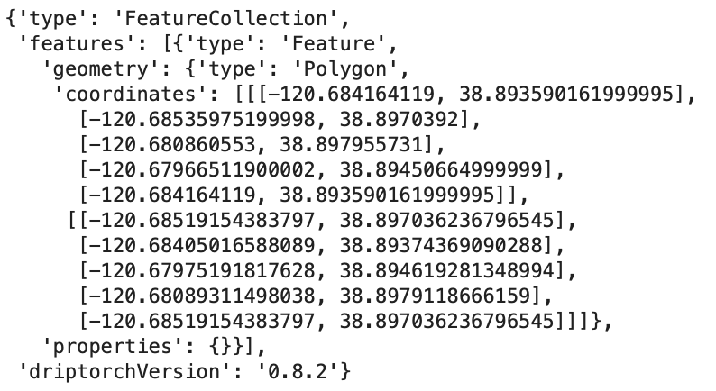
Pattern
Ignition Params
Fuel Removal Area

Slide 11
Ignition and Fuel Data Assessment
Lots of true/false values, not very helpful for ML features.
Hard to understand without documentation what all these numbers mean
Not sure how relevant information like fuel direction or coordinates are to the final runtime, maybe more EDA can reveal it
For now, not deemed a priority to look into, possible it could help though, but I’d like to understand a bit more what these inputs mean in the simulation.

Slide 12
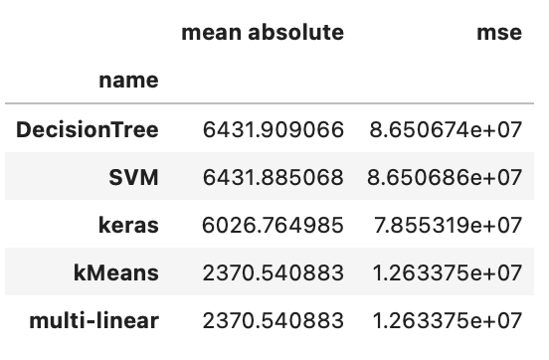
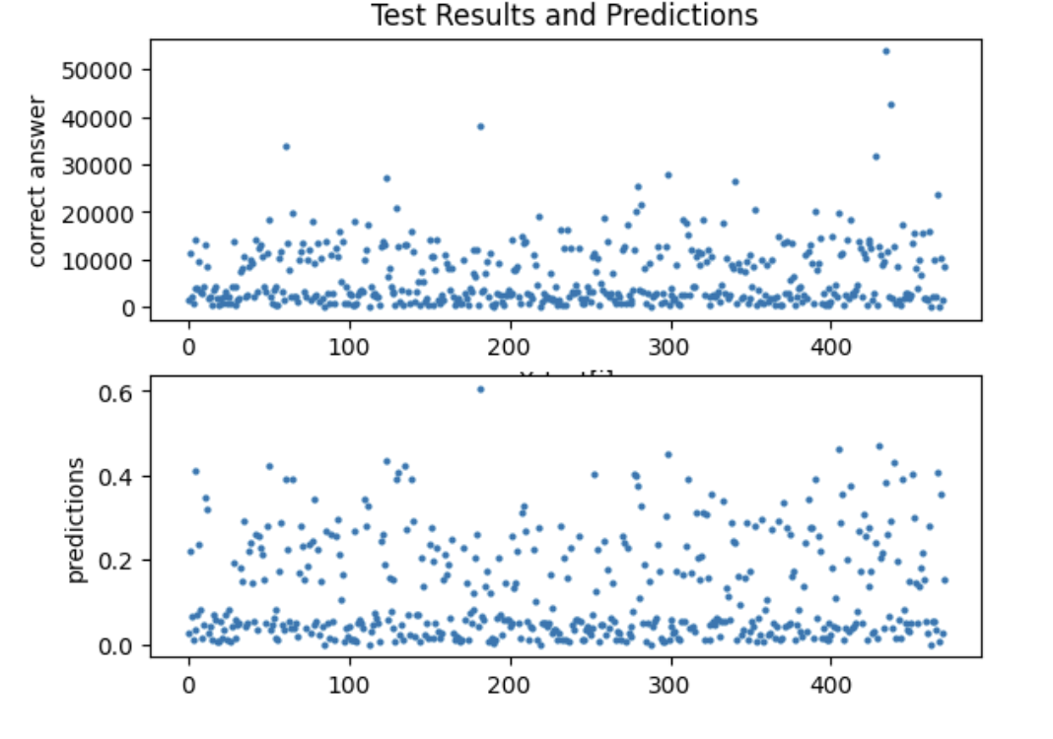
Regression
Didn’t get very good results with regression, the typical error was about 6000 seconds which is about 1.5 hours. Best model was a decision tree

Slide 13
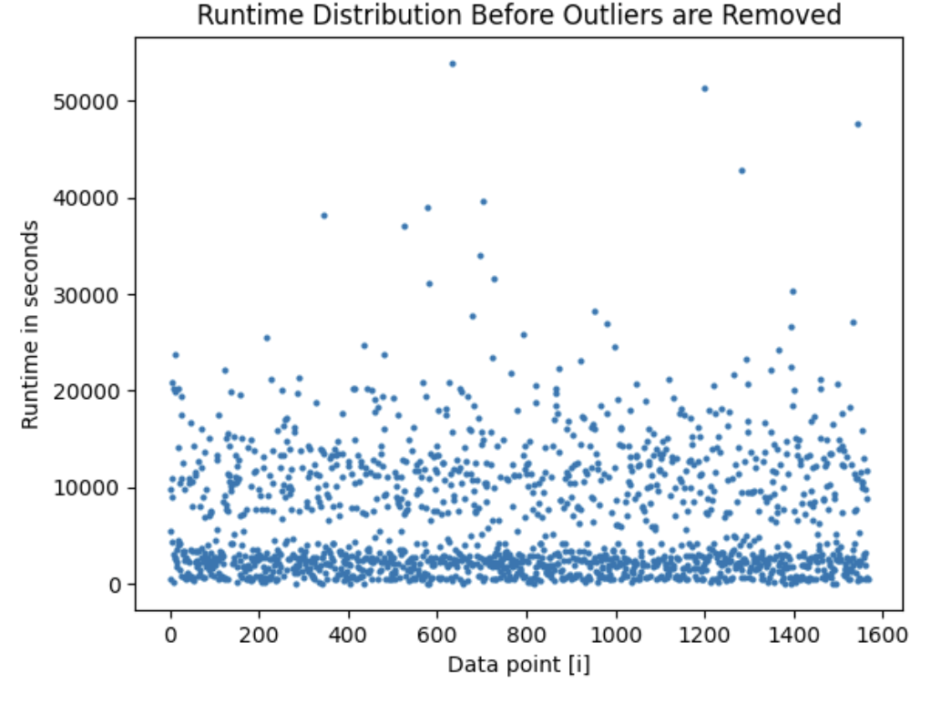
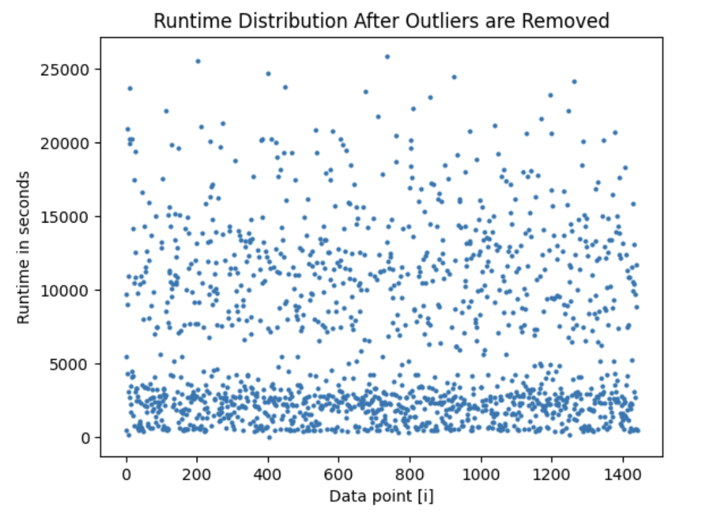
Classification
To start, I removed any large outliers, which was 125 data points. Then I split the data into equally sized buckets, and saw which models would do best. I changed hyperparameters to be optimal but for the most part used out of the box models from sklearn

Slide 14
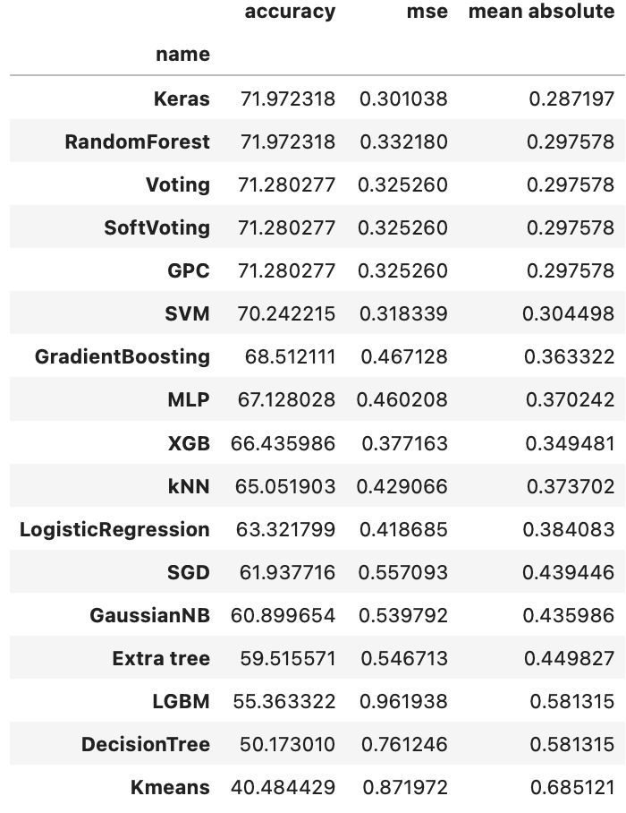
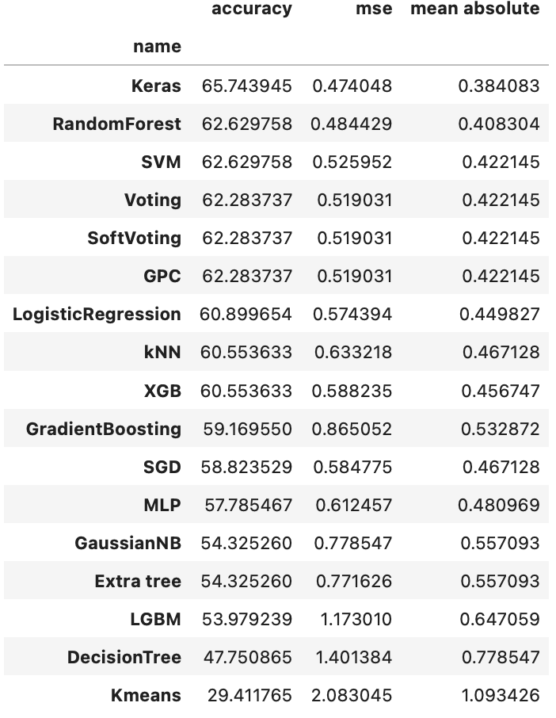
4 Categories
5 Categories

Slide 15
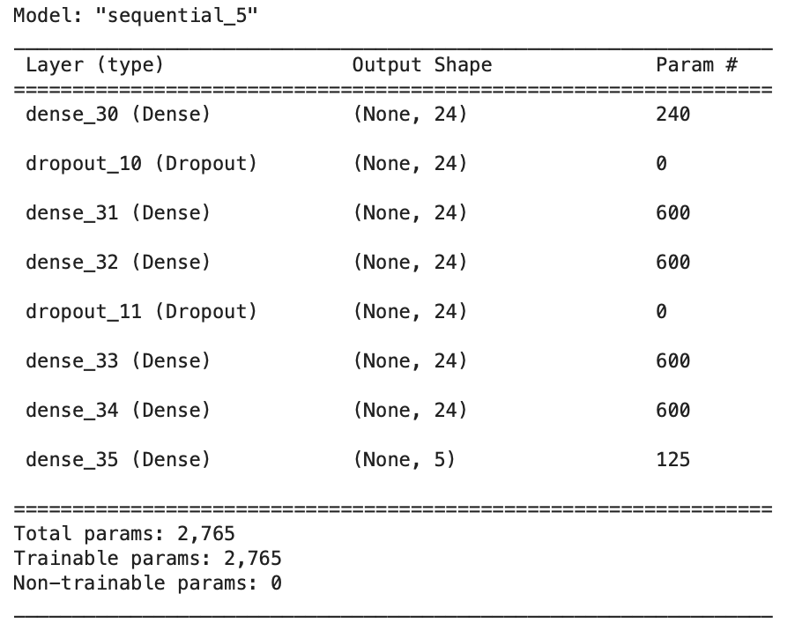
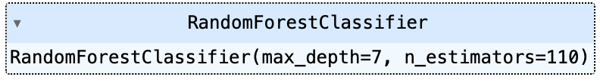
Findings
Custom neural nets seem to do well as expected, but really the best model seems to be the Random Forest model with 110 estimators which tends to match or outperform the tensorflow model. I used lots of hyperparameter testing to find the best number of estimators. Hopefully some improvement could help the tensorflow model which is definitely overfitting, but it’s still not far and above the other models.

Slide 16
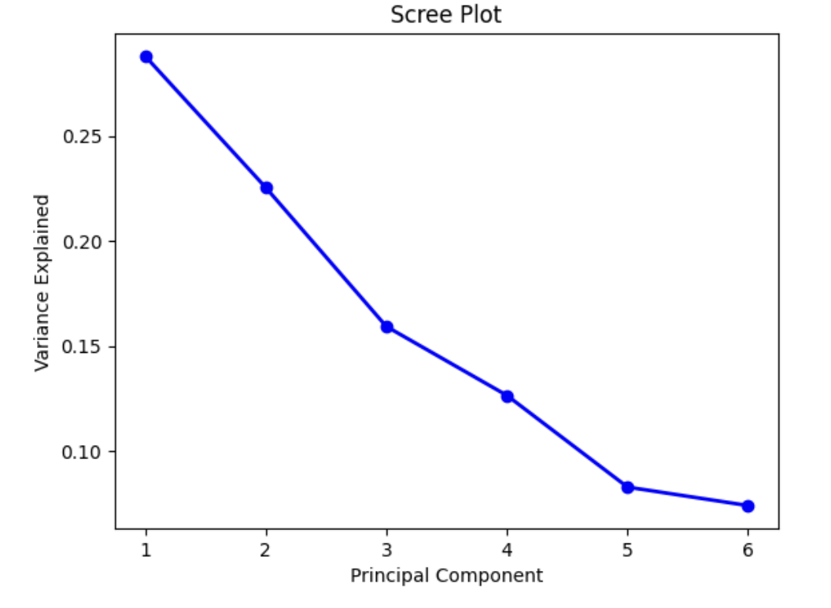
Principal Component Analysis
PCA is a process that reduces a dataset from the amount of columns it has to just n features you can decide, by condensing data using a mathematical formula.
Does it help to do PCA to reduce the number of features in the training data? This reduces dimensionality, supposedly making it easier for models to pick up on patterns. Lets test with reducing the number of features, which is 9 before doing PCA

Slide 17
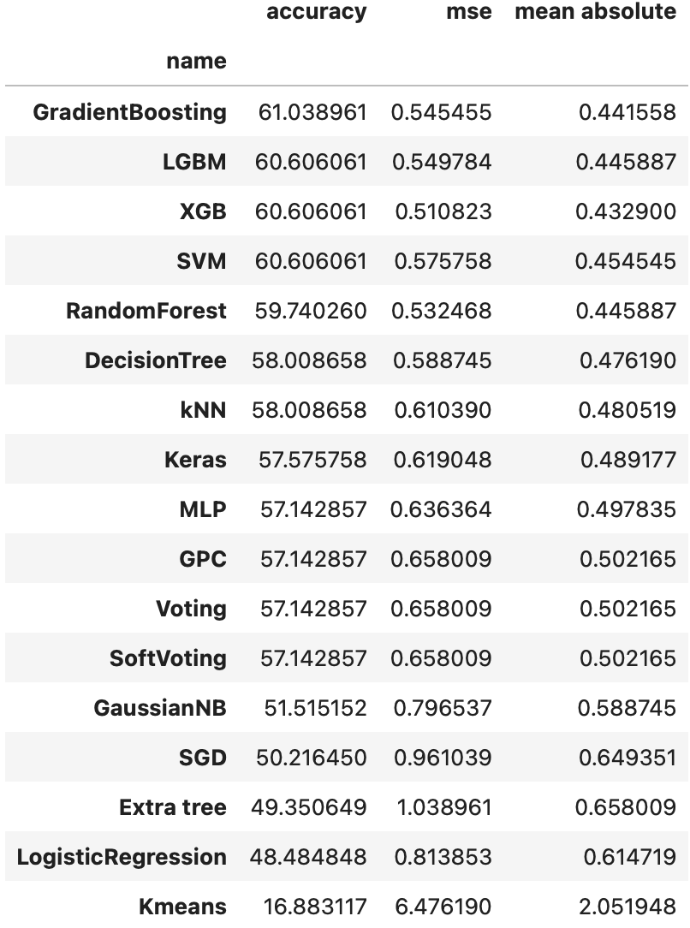
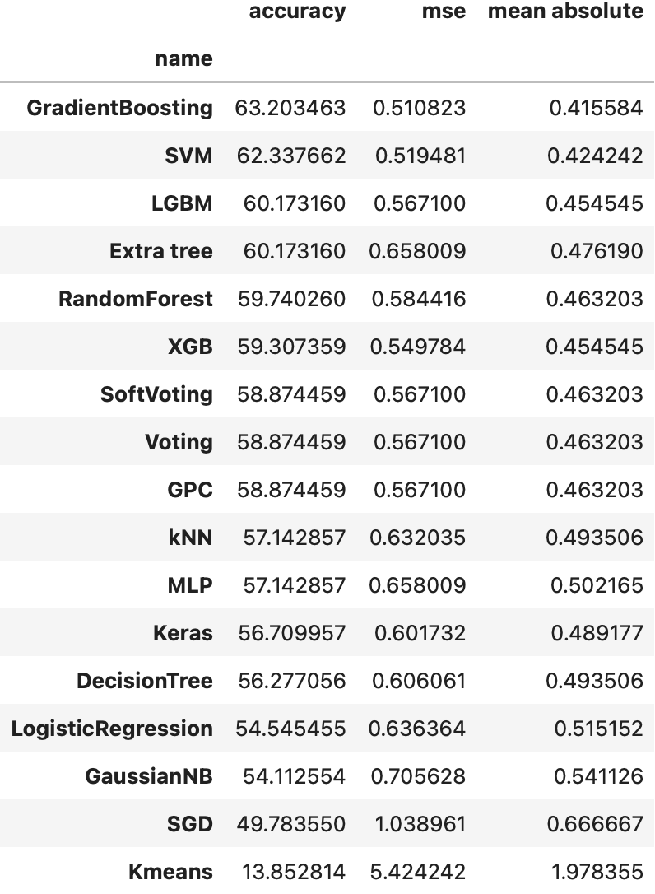
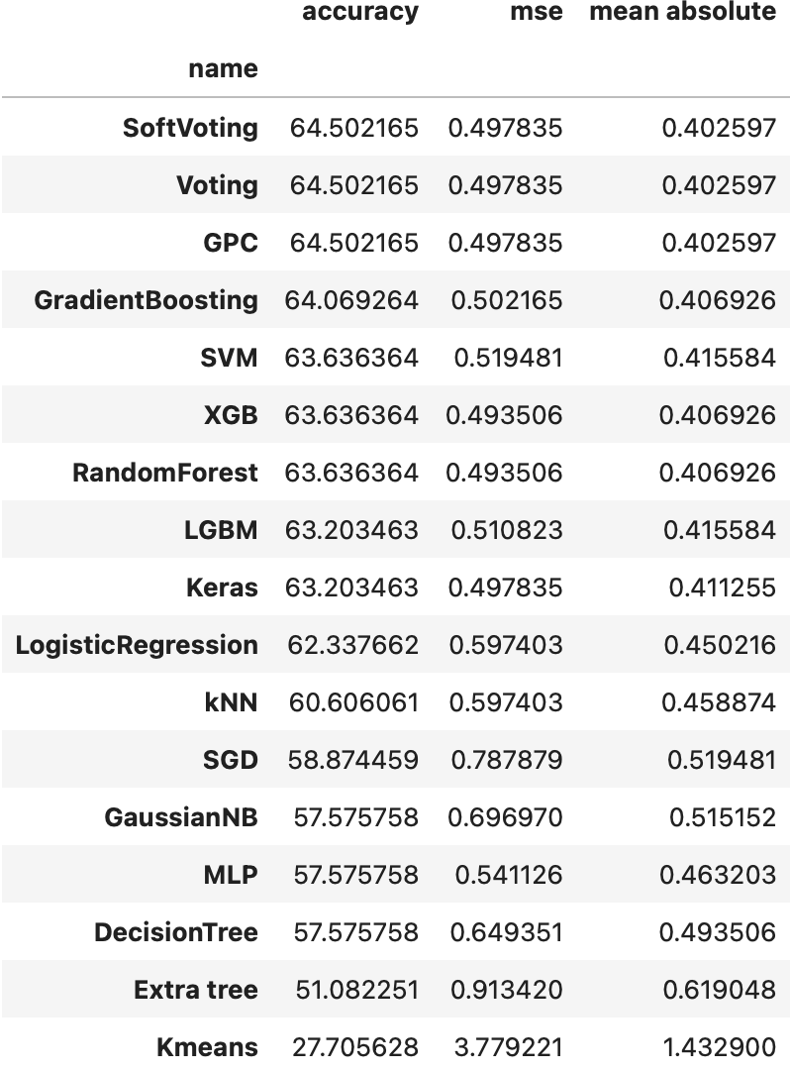
Principal Component Analysis (5 categories)
3 components
5 components
7 components

Slide 18
PCA Observations
Interesting to note which models do better and how much it is not consistent. Seems the neural networks (keras) are not so powerful anymore with this new training data

Slide 19
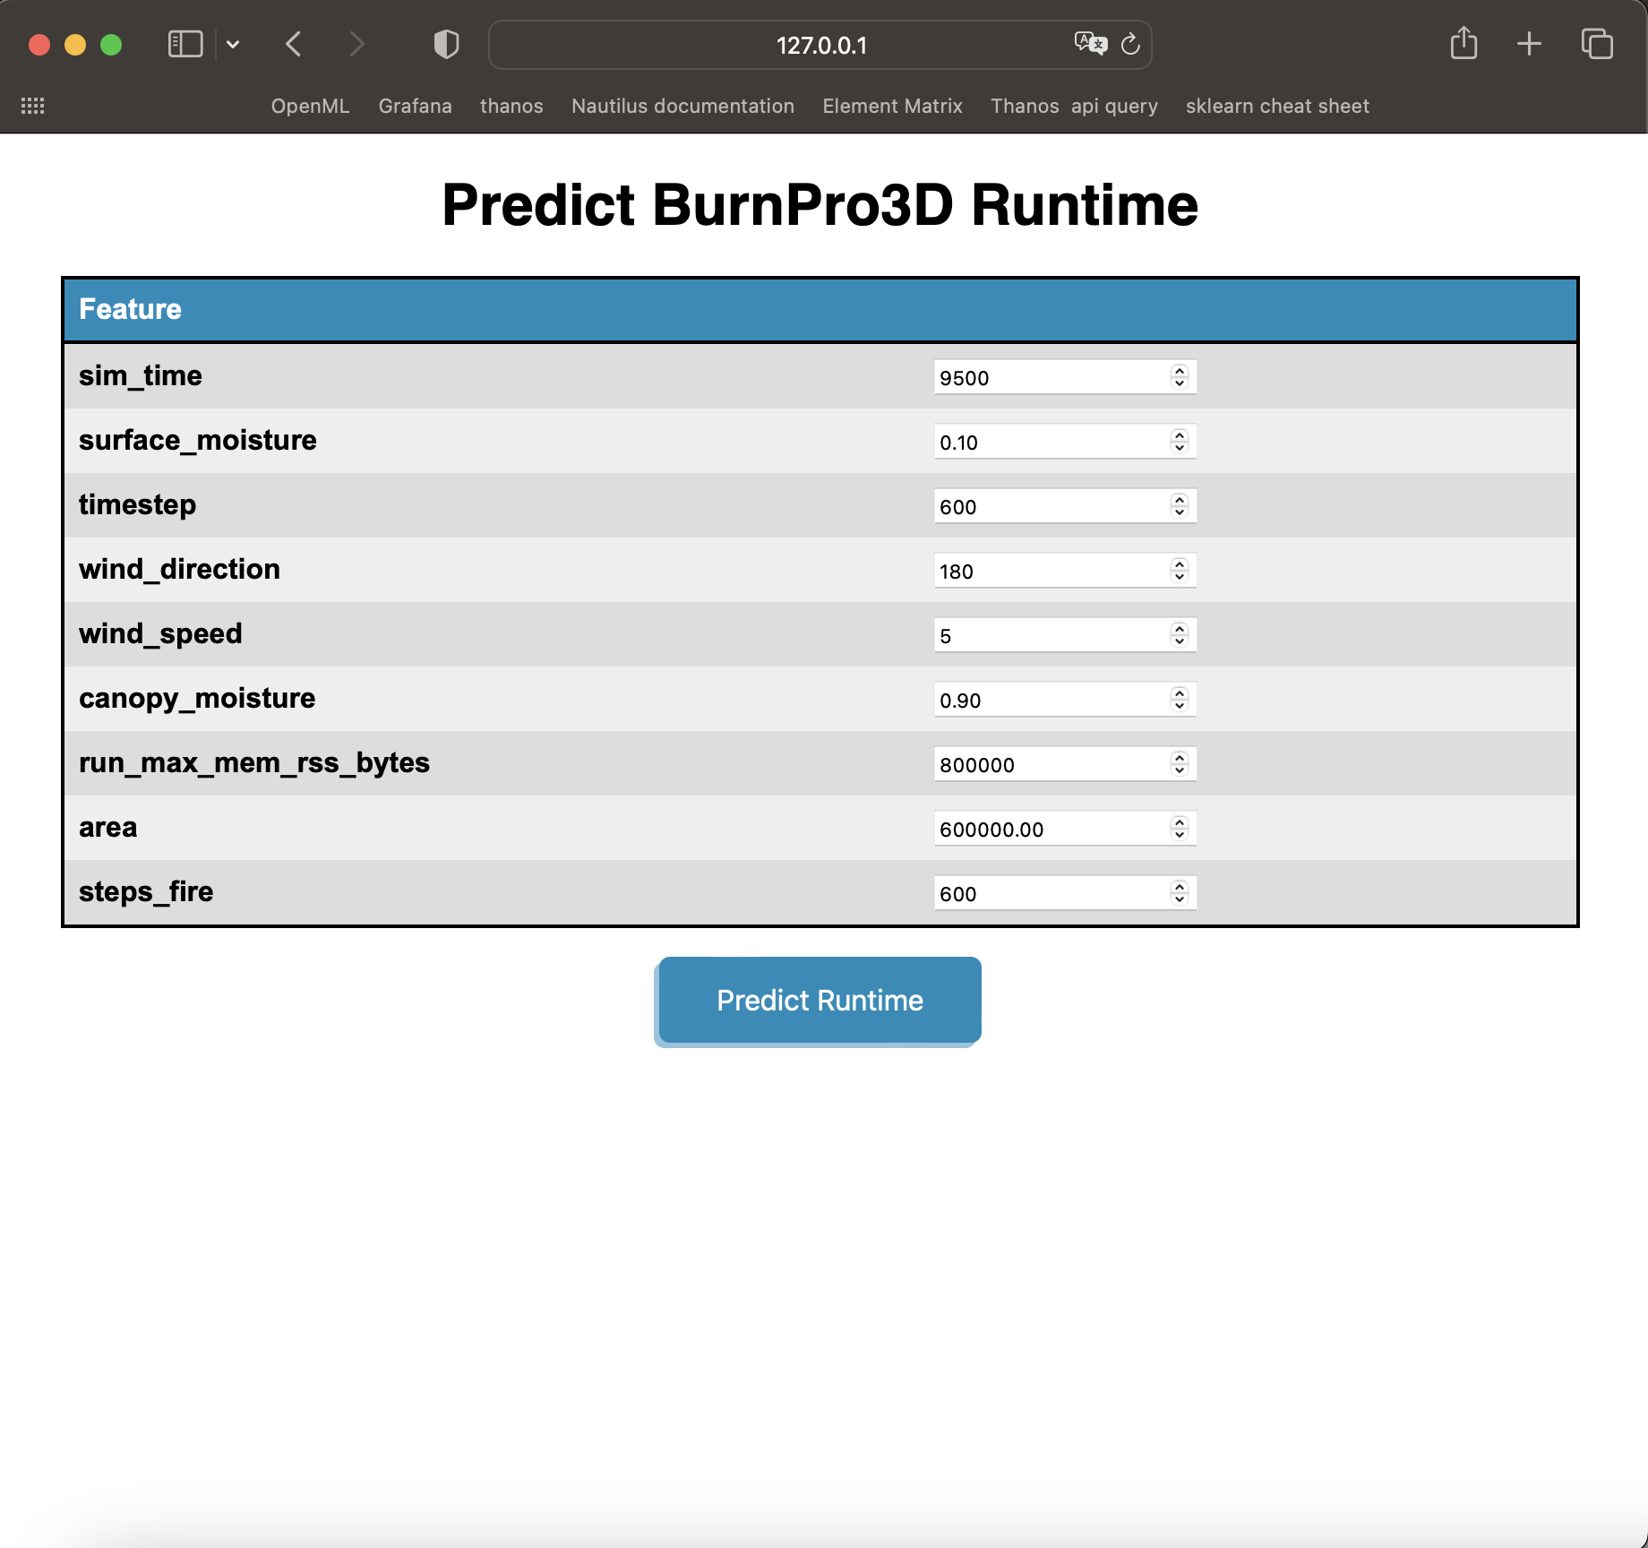
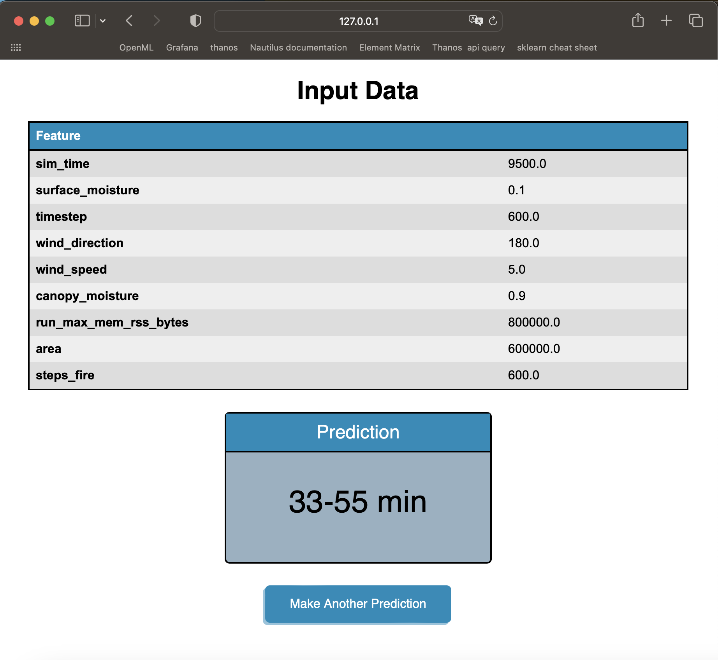
Live Prediction Inferencing

